Slide 1

Summer Training Presentation
On
Web Development Course
GLA University
Mathura – 281406, India
Submitted By :
Kartik Varshney 181500313

Slide 2
CONTENTS
Introduction
Objective
Technologies Used
Features Of Website
Conclusion
Experience
Bibliography

Slide 3
INTRODUCTION
ESTABLISHMENT OF COMPANY :
Udemy, Inc. is an American online learning platform aimed at professional adults and students.
It was founded in May 2010 by Eren Bali, Gagan Biyani, and Oktay Caglar.
As of January 2020, the platform has more than 50 million students and 57,000 instructors teaching courses in over 65 languages.

Slide 4
              OBJECTIVE
The main reason to select this Web Development Course is that it is able to describe the structure and functionality of all coding required for front-end and back-end.
Also, Web Development Field is getting popular because it is easy to implement and every company needs a website to show its work and attract users to use its products.
It is interesting to work with new tools and technologies to develop ourselves.

Slide 5
TECHNOLOGIES USED
Front-End :
    HTML
    CSS
    BOOTSTRAP
Back-End :
    PHP
    MYSQL
TOOLS USED :
    VS code
    XAMPP server
    Google Chrome

Slide 6
TECHNOLOGIES USED
HTML : Hypertext Markup Language is the standard mark-up language for creating web pages and web applications.
CSS : Cascading Style Sheet which is used to make attractive web pages and styling.
BOOTSTRAP : Bootstrap is a front-end framework used to create modern web pages and applications as well as make them responsive.
PHP : Hypertext Processor is a server side scripting language designed for web development but also used as a general-purpose programming language.

Slide 7
FEATURES OF WEBSITE
Home Page
Books Page
Previous Year Page
About Us Page
Contact Us Page

Slide 8

FEATURES OF WEBSITE
Home Page :
It contains basic information about the website.

Slide 9
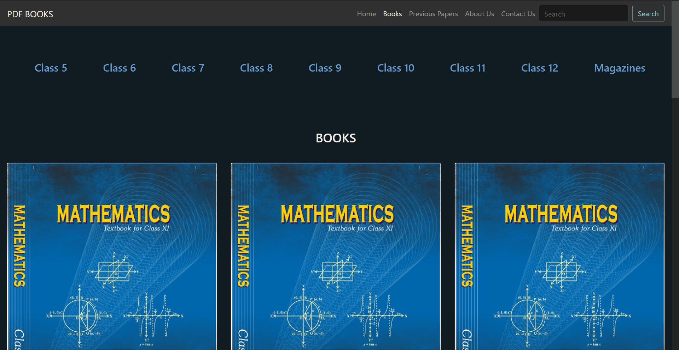
FEATURES OF WEBSITE
Books Page :
It contains different kind of books to read and learn. Also contains magazines.

Slide 10
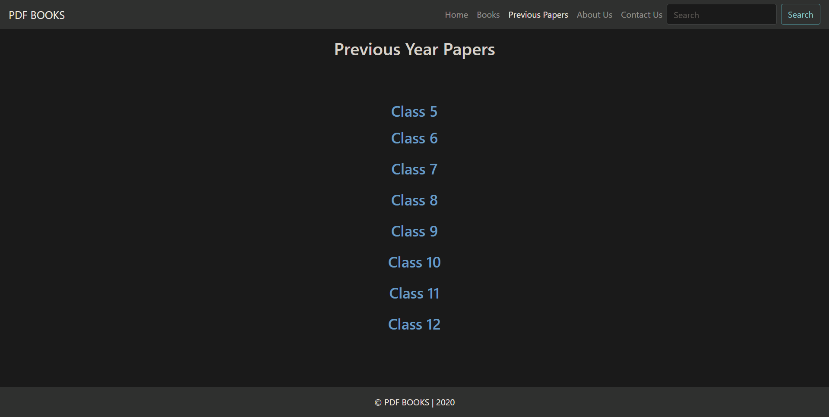
FEATURES OF WEBSITE
Previous Year Papers Page :
It is having previous year papers.

Slide 11
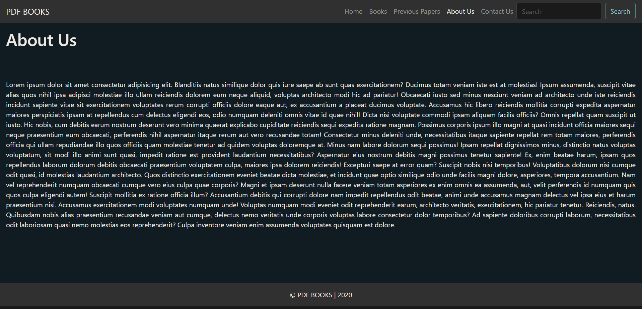
FEATURES OF WEBSITE
About Us Page :
It contains detailed information about the website.

Slide 12
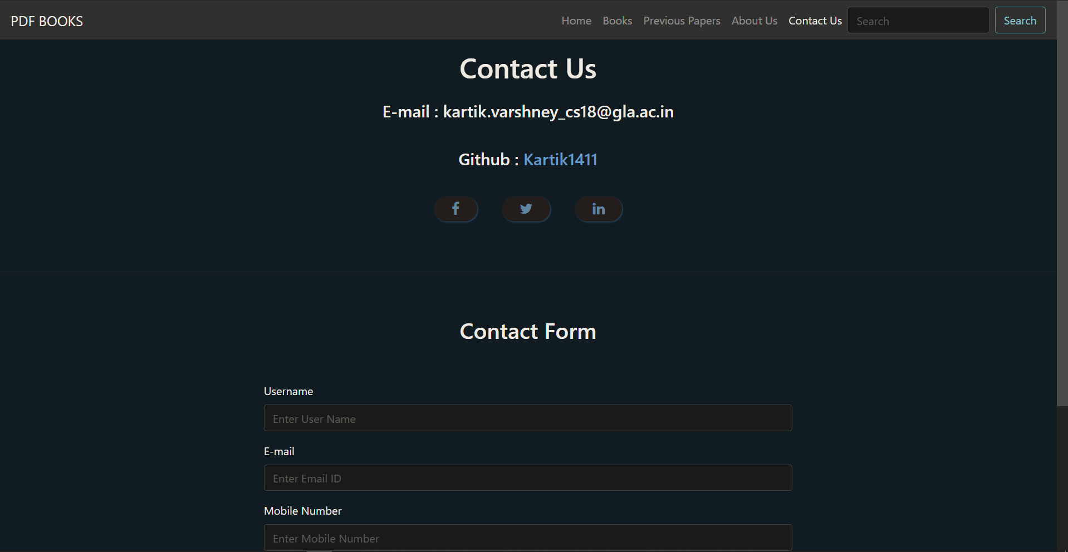
FEATURES OF WEBSITE
Contact Us Page :
It contains contact details and a contact form or feedback form.

Slide 13
CONCLUSION
The above implementation resulted in a basic PDF BOOKS website which is compilation of material that exemplifies user skills, qualification and education.
This project is a classic example, that learning of concepts needs to be supplemented with application of that knowledge.

Slide 14
CHALLENGES
There are many types of challenges that I faced during this Project and Completion of Course but at the end of this course and project I learned a lot and acquire a great experience of working on project that related to real world problem.
Here are some most common challenges that I faced during this Project and Course:
Learning some new language
Working on different language at same time
Managing coordination between all the modules
Syntactical Errors
Connectivity issue between front end and back end
Network issue
Finding problem and try to solve them on our own with the help of articles and some other references

Slide 15
EXPERIENCE
It was quite interesting to see the things appearing on the front-end of the website with several codes running at the back-end.
Although I found it a bit challenging but exploring this filed was equally amazing.
The experience of working on Udemy was good.

Slide 16
BIBLIOGRAPHY
1. Robin Nixon Learning PHP, MYSQL and Java Script with JQuery, CSS & HTML5: O’RELLY 4th Edition 2014.
2. Udemy Web Development master class Complete Certification Course https://www.udemy.com/course/web-development-masterclass-complete-certificatecourse/
3. Macy Storm D2C Website Examples: 6 Examples of Direct to Consumer brands https://www.webfx.com/blog/web-design/d2c-website-examples/
4. Beta Labs Introduction to HTML https://www.beta-labs.in/2020/06/introduction-tohtml.html
5. Beta Labs Introduction to CSS https://www.beta-labs.in/2020/07/introduction-tocss.html
6. Beta Labs Introduction to PHP https://www.beta-labs.in/2020/05/introduction-tophp.html
7. MDN Web Docs HTML: Hyper text Markup Language https://developer.mozilla.org/en-US/docs/Web/HTML

Slide 17
BIBLIOGRAPHY
8. MDN Web Docs CSS : Cascading Style Sheet https://developer.mozilla.org/en-US/docs/Web/CSS
9. MDN Web Docs JavaScript https://developer.mozilla.org/en-US/docs/Web/JavaScript
10. Code With Harry Complete PHP https://www.youtube.com/watch?v=at19OmH2Bg4&list=PLu0W_9lII9aikXkRE0WxDt1vozo3hnmtR&ab_channel=CodeWithHarry
11. Silberschatz−Korth−Sudarshan Database System Concepts, 4 th Edition : The McGraw−Hill Companies, 2001
12. FontAwsome Uses of Fonts and Icons https://fontawesome.com/
13. BootStrap BootStrapDocumentation https://getbootstrap.com/

Slide 18
THANK YOU !

